Slide 1
Testing methods for airway hyperresponsiveness in asthma^{1–3}
Direct tests^{1,2}
Indirect tests^{1,2}
Methacholine*
Histamine
Mannitol*
Hypertonic saline
AMP
Exercise challenge
EVH
Stimulation of airway smooth muscle and bronchoconstriction¹
High sensitivity^{2,3}
Low specificity^{2,3}
Low sensitivity^{2,3}
High specificity^{2,3}
Primary use: To rule out asthma^{2,3}
If the test is negative, a patient is very unlikely to have asthma^{2,3}
Primary use: To rule in asthma^{2–4}
Airway hyperresponsiveness testing results should be interpreted alongside clinical aspects of asthma^{2,4}
AMP, adenosine monophosphate; EVH, eucapnic voluntary hyperventilation
1. Chapman DG, Irvin CG. Clin Exp Allergy 2015;45:706–719; 2. Comberiati P, et al. Immunol Allergy Clin North Am 2018;38:545–571; 3. Cockcroft DW. Chest 2010;138(Suppl. 2):18S–24S; 4. Coates AL, et al. Eur Respir J 2017;49:1601526
Veeva ID: GB-48355; date of preparation: September 2023. © 2023 AstraZeneca. All Rights Reserved. This information is intended for healthcare professionals only. EpiCentral is sponsored and developed by AstraZeneca.
Notes:
Comberiati 2018, pg 8-9, Correlations Between Direct and Indirect Challenges
Chapman 2015, pg 3-4, Methacholine vs Mannitol section
O’Byrne 2003, pg 2, Direct Acting and Indirect Acting Stimuli, col1, last para & pg 3, para 1
Comberiati 2018, p 8, Correlations Between Direct and Indirect challenges, lines 7-11 & pg 9, line 1
Chapman 2015, pg 3, Methacholine vs Mannitol,
Lines 1-3
Notes
ª Comberiati 2018, p 9, para 2, lines 4-7
^{b} Comberiati 2018, p 13, para 2, lines 1-7 & para 3, line 3

Slide 2
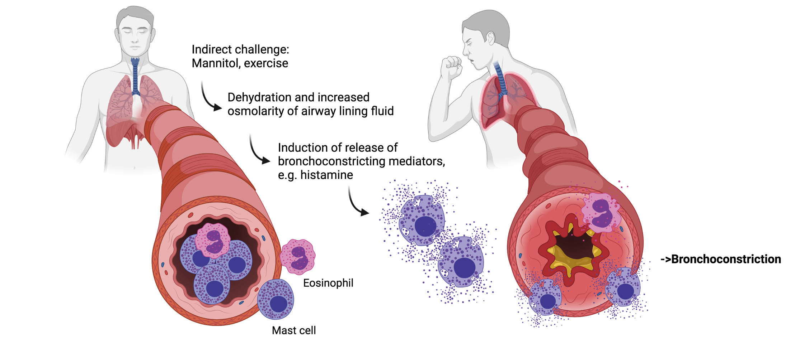
Airway hyperresponsiveness and airway inflammation
Airway hyperresponsiveness to an indirect bronchial challenge test, such as mannitol, mimics active airway inflammation^{1,2}
Indirect challenge: mannitol, exercise
Mucosal dehydration and increased osmolarity of airway lining fluid
Induction of release of bronchoconstricting mediators, eg histamine
Bronchoconstriction
Eosinophil
Mast cell
Image copyright: Celeste Porsbjerg
This is an illustrative representation of the airway and the effect of an indirect airway hyperresponsiveness challenge; the airway and inflammatory cells are not to scale 1. Brannan JD, Lougheed MD. Front Physiol 2012;3:460; 2. Sverrild A, et al. Clin Exp Allergy 2016;46:288–297
Veeva ID: GB-48355; date of preparation: September 2023. © 2023 AstraZeneca. All Rights Reserved. This information is intended for healthcare professionals only. EpiCentral is sponsored and developed by AstraZeneca.

Slide 3
Methacholine and mannitol challenge tests
Test | Mechanism | Measurements | Cutoff level | Interpretation of airway hyperresponsiveness
Methacholine challenge¹*† | Inhaled methacholine mimics the neurotransmitter acetylcholine to directly interact with muscarinic receptors on airway smooth muscle, resulting in bronchoconstriction | PC₂₀ or PD₂₀ to methacholine: the provoking concentration or delivered dose of methacholine required to induce 20% reduction in FEV₁ from baseline† | 25–100 μg / 0.13–0.50 μmol / 1–4 mg/mL | Mild
 |  |  | 6–25 μg / 0.03–0.13 μmol / 0.25–1 mg/mL | Moderate
 |  |  | <6 μg / <0.03 μmol / <0.25 mg/mL | Marked
Mannitol challenge^{2–5} | Inhalation of mannitol rapidly increases the osmolarity of the airway surface liquid, causing stimulation of inflammatory cells (ie mast cells and eosinophils) and release of mediators, mimicking airway inflammation | PD₁₅ to mannitol: the provoking cumulative total dose of mannitol required to induce ≥15% reduction in FEV₁ from baseline or a 10% decrease in FEV₁ between two consecutive mannitol doses | >155 mg | Mild indirect
 |  |  | >35 mg to ≤155 mg | Moderate indirect
 |  |  | ≤35 mg | Severe indirect
*Challenge test results expressed as provocative dose (PD) or provocative concentration (PC) are dependent on the output rate of the administration device, time of aerosol inhalation and particle size distribution. Evidence shows that the methacholine dose, expressed as PD₂₀, allows more consistent correlation of results than PC₂₀ when comparing responses captured by different protocols. Consistency of timing between steps and from dosing to spirometry remains important to properly compare results. The PD₂₀ is the dose of methacholine that causes a 20% fall in FEV₁ and is calculated in the same way as the PC₂₀.¹ †To determine changes in airway reactivity following therapy in patients known to have asthma, using doubling doses will give more precise PD₂₀ values to compare¹ FEV₁, forced expiratory volume in 1 second
1. Coates AL, et al. Eur Respir J 2017;49:1601526; 2. Hallstrand TS, et al. Eur Respir J 2018;52:1801033; 3. Comberiati P, et al. Immunol Allergy Clin North Am 2018;38:545–571; 4. Brannan JD, Lougheed MD. Front Physiol 2012;3:460; 5. Sverrild A, et al. Clin Exp Allergy 2016;46:288–297
Veeva ID: GB-48355; date of preparation: September 2023. © 2023 AstraZeneca. All Rights Reserved. This information is intended for healthcare professionals only. EpiCentral is sponsored and developed by AstraZeneca.
Notes:
Coates 2017, pg 2, Provocative Dose para
Coates 2017, pg 14, table 6
Hallstrand 2018, pg10, para 5, lines 5-6 & pg 11, fig 3
Diver 2021, pg 5, para 2
Hallstrand 2018, pg 10, para 5, lines 1-2
Coates 2017, pg 2, Direct Challenge Tests para
Hallstrand 2018, pg 10, para 3, lines 4-5
Comabtieri 2018, pg 8, Correlations Between Direct and Indirect Challenges ( last para) lines 8-10
Note a: Coates 2017, pg 8,
Provocative Dose vs Provocative Concentration, para 1, lines 3-5 &
Para 2, lines 6-8 and 11-13.

Slide 4
Interpreting results of airway hyperresponsiveness bronchoprovocation tests
Change in FEV₁ as measured by PC₂₀ value by methacholine challenge test in patients with or without asthma^{1,2}
50
Severe asthmatic
Airway hyperresponsiveness is a valuable tool in the clinical assessment of patients with possible asthma, asthma-like symptoms, or, generally normal/ non-diagnostic lung function³
In patients with asthma, bronchoconstriction (PC₂₀ as seen by reduction in FEV₁)* starts at a lower inhaled concentration of the agonist methacholine²
Maximal bronchoconstrictor responses are also greater in those with asthma^{1,2†}
Patients with normal healthy airways achieve a plateau response to the bronchoconstrictor stimulus, whereas patients with mild to severe asthma may not^{1,2}
B
40
Mild asthmatic
30
FEV₁ (% reduction)
A
A
20
Normal healthy
B
10
PC₂₀ values
Figure adapted from O’Byrne PM, Inman MD. Chest 2003;123(Suppl. 3):411S–416S and Nair P. J Allergy Clin Immunol Pract 2017;5:649–659
*PC₂₀ greater than 16 mg/mL represents normal airway responsiveness;⁴ 4–16 mg/mL is borderline airway hyperresponsiveness;⁴ 1–4 mg/mL represents mild airway hyperresponsiveness;⁴ 0.25–1 mg/mL represents moderate airway hyperresponsiveness;⁴ and <0.25 mg/mL represents marked airway hyperresponsiveness.⁴ †For safety reasons, methacholine testing is stopped if there has been a >20% fall in FEV₁⁴
FEV₁, forced expiratory volume in 1 second; PC₂₀, provocation concentration of methacholine causing a 20% fall in FEV₁
1. O’Byrne PM, Inman MD. Chest 2003;123(Suppl. 3):411S–416S; 2. Nair P. J Allergy Clin Immunol Pract 2017;5:649–659; 3. Cockcroft DW, et al. Allergy Asthma Clin Immunol 2020;16:14; 4. Coates AL, et al. Eur Respir J 2017;49:1601526
0
0.25
0.5
1
2
4
8
16
32
64
128
256
Methacholine concentration (mg/mL)
Veeva ID: GB-48355; date of preparation: September 2023. © 2023 AstraZeneca. All Rights Reserved. This information is intended for healthcare professionals only. EpiCentral is sponsored and developed by AstraZeneca.
Notes:
Nair 2017, pg 2, Fig 1 and col 1, para 3 (1.,3.,4.)
B1: Cockcroft 2020 pg 1 col 1

Slide 5
Contraindications for airway hyperresponsiveness testing
There are several general contraindications for performing tests for airway hyperresponsiveness¹
There are also several specific contraindications for performing direct and indirect tests^{1,2}
Moderate/severe airflow limitation
Cardiovascular problems
Eye surgery
Pregnancy or nursing mothers
Inability to reproduce quality spirometry results consistently
Direct tests¹
Indirect tests²
Current use of cholinesterase inhibitor medication
Hypersensitivity to mannitol
Presence of comorbidities that could be exacerbated by frequent coughing
1. Coates AL, et al. Eur Respir J 2017;49:1601526; 2. Hallstrand TS, et al. Eur Respir J 2018;52:1801033
Veeva ID: GB-48355; date of preparation: September 2023. © 2023 AstraZeneca. All Rights Reserved. This information is intended for healthcare professionals only. EpiCentral is sponsored and developed by AstraZeneca.
Notes:
Nair 2017, pg 2, Fig 1 and col 1, para 3 (1.,3.,4.)
B1: Cockcroft 2020 pg 1 col 1

