Slide 1
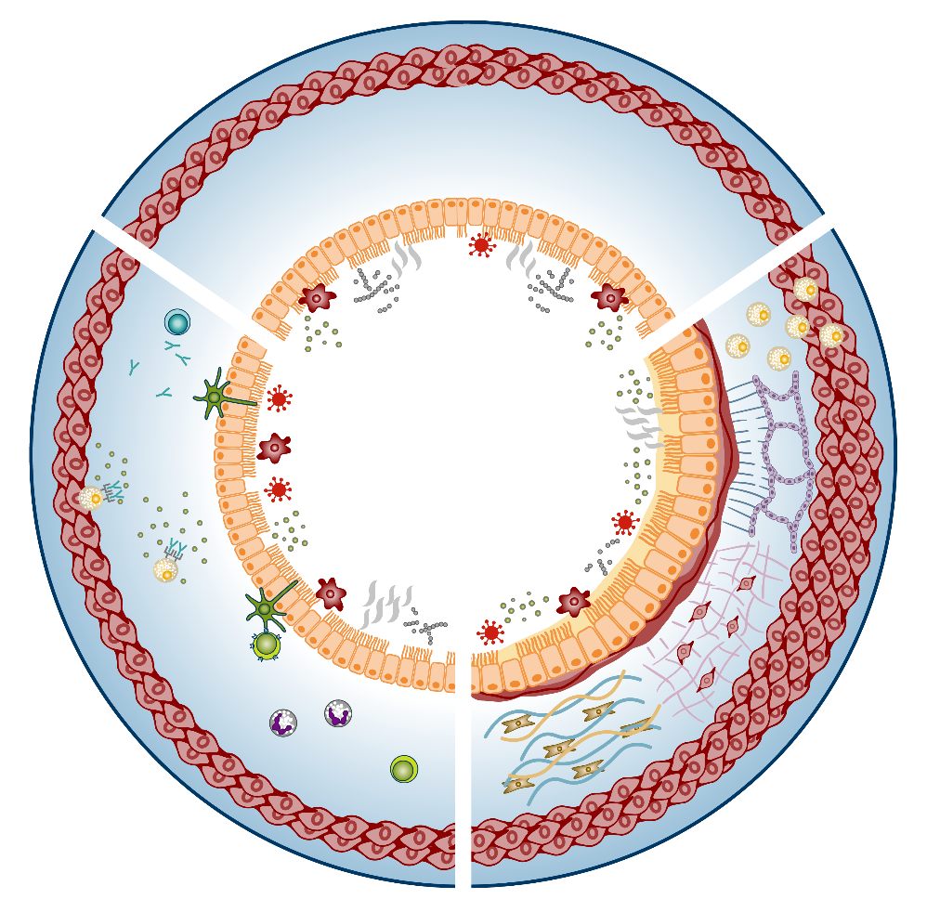
Airway hyperresponsiveness: a complex interplay between airway inflammation, airway remodelling and structural changes^{1,2}
Key
Airway smooth muscle cell
Healthy airway
Allergens
Bacteria
Collagen subtypes I and III
Cytokines
Allergens, viruses, bacteria, pollutants,
smoke⁶
Dendritic cell
Airway
inflammation^{1,3–5}
Airway remodelling and structural changes^{7–16}
Eosinophil
Epithelial cell
Extracellular matrix
Fibroblast
IgE
ILC2
Mast cell
Variable contributions^{1,2}
Persistent contributions^{1,2}
Parenchyma
Pollutants
Airway hyperresponsiveness
Smoke
Th2 cell
Viruses
IgE, immunoglobulin E; ILC2, type 2 innate lymphoid cell; Th, T helper 1. Comberiati P, et al. Immunol Allergy Clin North Am 2018;38:545–571; 2. Busse W. Chest 2010;138(Suppl. 2):4S–10S; 3. Roan F, et al. J Clin Invest 2019;129:1441–1451; 4. Gunst SJ, Panettieri RA Jr. J Appl Physiol (1985) 2012;113:837–839; 5. Chapman DG, Irvin CG. Clin Exp Allergy 2015;45:706–719; 6. Gauvreau GM, et al. Expert Opin Ther Targets 2020;24:777–792; 7. Jeffery PK, et al. Am Rev Respir Dis 1989;140:1745–1753; 8. Boulet LP, et al. Chest 1997;112:45–52; 9. Booms P, et al. J Allergy Clin Immunol 1997;99:330–337; 10. Gelb AF, Zamel N. Curr Opin Pulm Med 2002;8:50–53; 11. Slats AM, et al. J Allergy Clin Immunol 2008;121:1196–1202; 12. Ward C, et al. Thorax 2002;57:309–316; 13. Brightling CE, et al. N Engl J Med 2002;346:1699–1705; 14. Bradding P, Arthur G. Clin Exp Allergy 2016;46:194–263; 15. Berair R, et al. J Allergy (Cairo) 2013;2013:185971; 16. Gil FR, Lauzon A-M. Can J Physiol Pharmacol 2007;85:133–140
Veeva ID: GB-48354; date of preparation: September 2023. © 2023 AstraZeneca. All Rights Reserved. This information is intended for healthcare professionals only. EpiCentral is sponsored and developed by AstraZeneca.

Slide 2
Airway hyperresponsiveness: a complex interplay between airway inflammation, airway remodelling and structural changes^{1,2}
Airway inflammation
Airway remodelling and structural changes
Healthy airway
In response to external triggers, epithelial cytokines may initiate an inflammatory response^{1,3}
Inflammatory chemokines and cytokines, mast cell activation and airway smooth muscle cell proliferation contribute to the bronchoconstriction and airway hyperresponsiveness^{1–5}
Severity of airway hyperresponsiveness positively correlates with the number of eosinophils and mast cells in the airway⁵
Airway hyperresponsiveness can occur independently of airway inflammation⁶
Airway remodelling and structural changes are associated with airway hyperresponsiveness^{8–13}
Infiltration of mast cells into airway smooth muscle and the resultant interactions between the two cell types are associated with disordered airway function and airway hyperresponsiveness^{14,15}
Fundamental physiological changes in the airway smooth muscle, known as airway hypercontractility, involve mast cells and are hypothesised to be another cause of airway hyperresponsiveness^{16,17}
Airway remodelling and its contributions to airway hyperresponsiveness is an area of evolving research^{5,18,19}
Allergens, viruses, bacteria, pollutants,
smoke⁷
Variable contributions^{1,2}
Persistent contributions^{1,2}
Airway hyperresponsiveness
1. Comberiati P, et al. Immunol Allergy Clin North Am 2018;38:545–571; 2. Busse W. Chest 2010;138(Suppl. 2):4S–10S; 3. Roan F, et al. J Clin Invest 2019;129:1441–1451; 4. Gunst SJ, Panettieri RA Jr. J Appl Physiol (1985) 2012;113:837–839; 5. Chapman DG, Irvin CG. Clin Exp Allergy 2015;45:706–719; 6. Crimi E, et al. Am J Respir Crit Care Med 1998;157:4–9; 7. Gauvreau GM, et al. Expert Opin Ther Targets 2020;24:777–792; 8. Jeffery PK, et al. Am Rev Respir Dis 1989;140:1745–1753; 9. Boulet LP, et al. Chest 1997;112:45–52; 10. Booms P, et al. J Allergy Clin Immunol 1997;99:330–337; 11. Gelb AF, Zamel N. Curr Opin Pulm Med 2002;8:50–53; 12. Slats AM, et al. J Allergy Clin Immunol 2008;121:1196–1202; 13. Ward C, et al. Thorax 2002;57:309–316; 14. Brightling CE, et al. N Engl J Med 2002;346:1699–1705; 15. Bradding P, Arthur G. Clin Exp Allergy 2016;46:194–263; 16. Berair R, et al. J Allergy (Cairo) 2013;2013:185971; 17. Gil FR, Lauzon A-M. Can J Physiol Pharmacol 2007;85:133–140; 18. Fehrenbach H, et al. Cell Tissue Res 2017;367:551–569; 19. Hough KP, et al. Front Med (Lausanne) 2020;7:191
Veeva ID: GB-48354; date of preparation: September 2023. © 2023 AstraZeneca. All Rights Reserved. This information is intended for healthcare professionals only. EpiCentral is sponsored and developed by AstraZeneca.

Slide 3
Multiple factors contribute to airway hyperresponsiveness: airway inflammation
The degree and/or severity of airway inflammation contributes to the variability of airway hyperresponsiveness in patients^{1,2}
However, airway hyperresponsiveness can occur independently of airway inflammation¹⁶
Triggers include allergens,^{3,4} infections,^{5,6} occupational triggers (TDI)^{7,8} and environmental triggers (O₃, NO₂, diesel exhaust)⁹
Epithelial cytokines, including TSLP, IL-25 and IL-33, are released from epithelial cells and induce the release of downstream inflammatory cytokines (eg IL-4, IL-5 and IL-13) that may drive inflammation, bronchoconstriction and airway hyperresponsiveness^{1,10,11}
Intraepithelial mast cells and eosinophils are also associated with indirect and endogenous airway hyperresponsiveness, respectively, with eosinophils also being associated with T2 inflammation^{12–14}
Severity of airway hyperresponsiveness positively correlates with the number of eosinophils and mast cells in the airways¹⁵
IL, interleukin; NO₂, nitrogen dioxide; O₃, ozone; T2, type 2; TDI, toluene diisocyanate; TSLP, thymic stromal lymphopoietin
1. Comberiati P, et al. Immunol Allergy Clin North Am 2018;38:545–571; 2. Busse W. Chest 2010;138(Suppl. 2):4S–10S; 3. Metzger WJ, et al. Chest 1986;89:477–483; 4. Cartier A, et al. J Allergy Clin Immunol 1982;70:170–177; 5. Empey DW, et al. Am Rev Respir Dis 1976;113:131–139; 6. Laitinen LA, et al. Am Rev Respir Dis 1991;143:358–361; 7. Mapp C, et al. Am Rev Respir Dis 1987;136:1403–1407; 8. Fabbri LM, et al. Am Rev Respir Dis 1987;136:36–42; 9. Olivieri D, Scoditti E. Eur Respir Rev 2005;14:51–56; 10. Gunst SJ, Pannettieri RA Jr. J Appl Physiol (1985) 2012;113:837–839; 11. Roan F, et al. J Clin Invest 2019;129:1441–1451; 12. Lai Y, et al. J Allergy Clin Immunol 2014;133:1448–1455; 13. Altman MC, et al. J Clin Invest 2019;129:4979–4991; 14. Al-Shaikhly T, et al. Eur Respir J 2022;60:2101865; 15. Chapman DG, Irvin CG. Clin Exp Allergy 2015;45:706–719; 16. Crimi E, et al. Am J Respir Crit Care Med 1998;157:4–9
Veeva ID: GB-48354; date of preparation: September 2023. © 2023 AstraZeneca. All Rights Reserved. This information is intended for healthcare professionals only. EpiCentral is sponsored and developed by AstraZeneca.

Slide 4
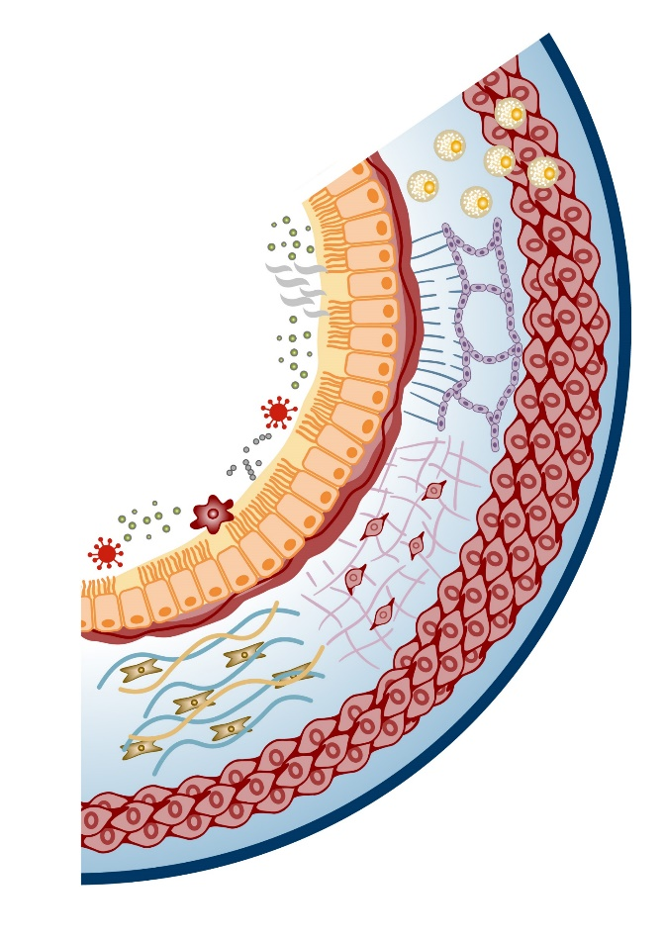
Multiple factors contribute to airway hyperresponsiveness: airway remodelling and structural changes
Airway remodelling, encompassing a range of structural changes, is considered to have permanent/persistent contributions to airway hyperresponsiveness^{1,2}
Infiltration of mast cells into airway smooth muscle and the resultant interactions between the two cell types are associated with disordered airway function and airway hyperresponsiveness^{3,4}
Fundamental physiological changes in the airway smooth muscle, known as airway hypercontractility, involve mast cells and are hypothesised to be another cause of airway hyperresponsiveness^{5,6}
Airway remodelling/structural changes and their contributions to airway hyperresponsiveness is an area of evolving research^{7–9}
Structural changes responsible for the bronchoconstriction observed in airway hyperresponsiveness include:
Epithelial damage¹⁰
Epithelial cell hyperplasia / airway wall thickening^{10,11}
Possible loss of airway tethering to parenchyma^{12,13}
Reticular basement membrane thickening^{10,14}
Airway smooth muscle hypertrophy and hyperplasia^{15,16}
Altered extracellular matrix¹⁷
Subepithelial fibrosis¹⁸
1. Comberiati P, et al. Immunol Allergy Clin North Am 2018;38:545–571; 2. Busse W. Chest 2010;138(Suppl. 2):4S–10S; 3. Brightling CE, et al. N Engl J Med 2002;346:1699–1705; 4. Bradding P, Arthur G. Clin Exp Allergy 2016;46:194–263; 5. Berair R, et al. J Allergy (Cairo) 2013;2013:185971; 6. Gil FR, Lauzon A-M. Can J Physiol Pharmacol 2007;85:133–140; 7. Chapman DG, Irvin CG. Clin Exp Allergy 2015;45:706–719; 8. Fehrenbach H, et al. Cell Tissue Res 2017;367:551–569; 9. Hough KP, et al. Front Med (Lausanne) 2020;7:191; 10. Jeffery PK, et al. Am Rev Respir Dis 1989;140:1745–1753; 11. Heijink IH, et al. Allergy 2020;75:1902–1917; 12. Mauad T, et al. Am J Respir Crit Care Med 2004;170:857–862; 13. Booms P, et al. J Allergy Clin Immunol 1997;99:330–337; 14. Ward C, et al. Thorax 2002;57:309–316; 15. Gelb AF, Zamel N. Curr Opin Pulm Med 2002;8:50–53; 16. James AL, et al. Am J Respir Crit Care Med 2012;185:1058–1064; 17. Slats AM, et al. J Allergy Clin Immunol 2008;121:1196–1202; 18. Boulet LP, et al. Chest 1997;112:45–52
Veeva ID: GB-48354; date of preparation: September 2023. © 2023 AstraZeneca. All Rights Reserved. This information is intended for healthcare professionals only. EpiCentral is sponsored and developed by AstraZeneca.

